Slide 1










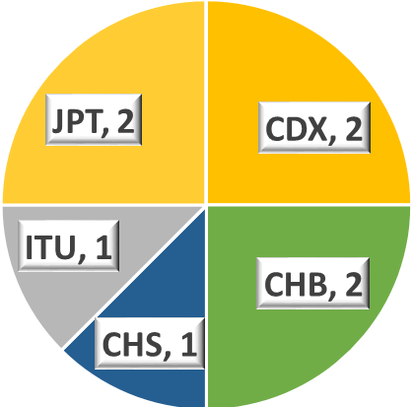
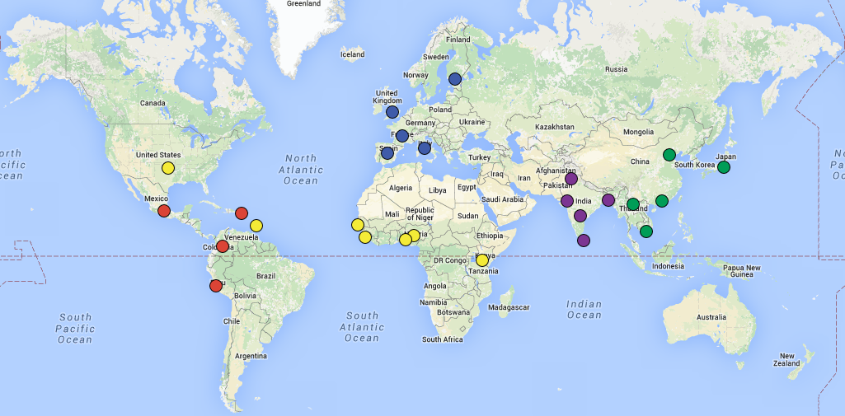
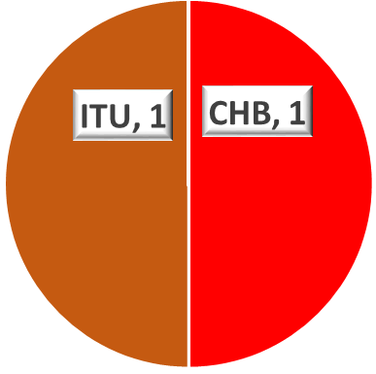
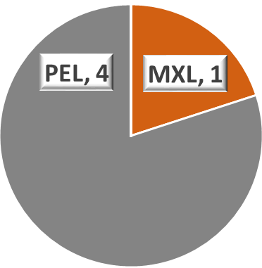
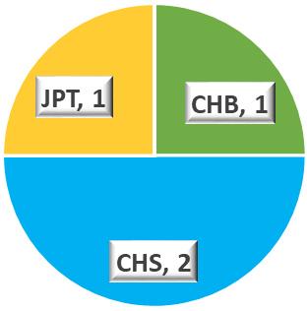
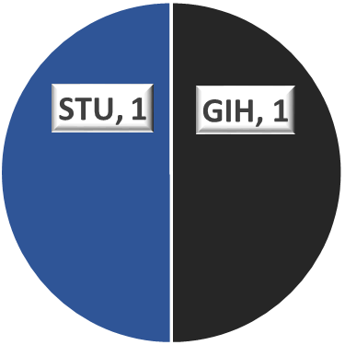
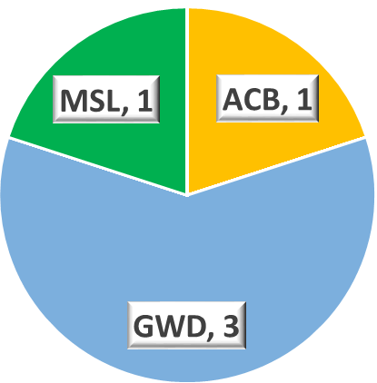
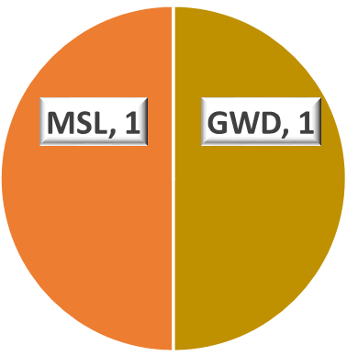
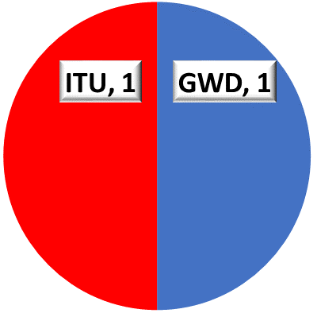
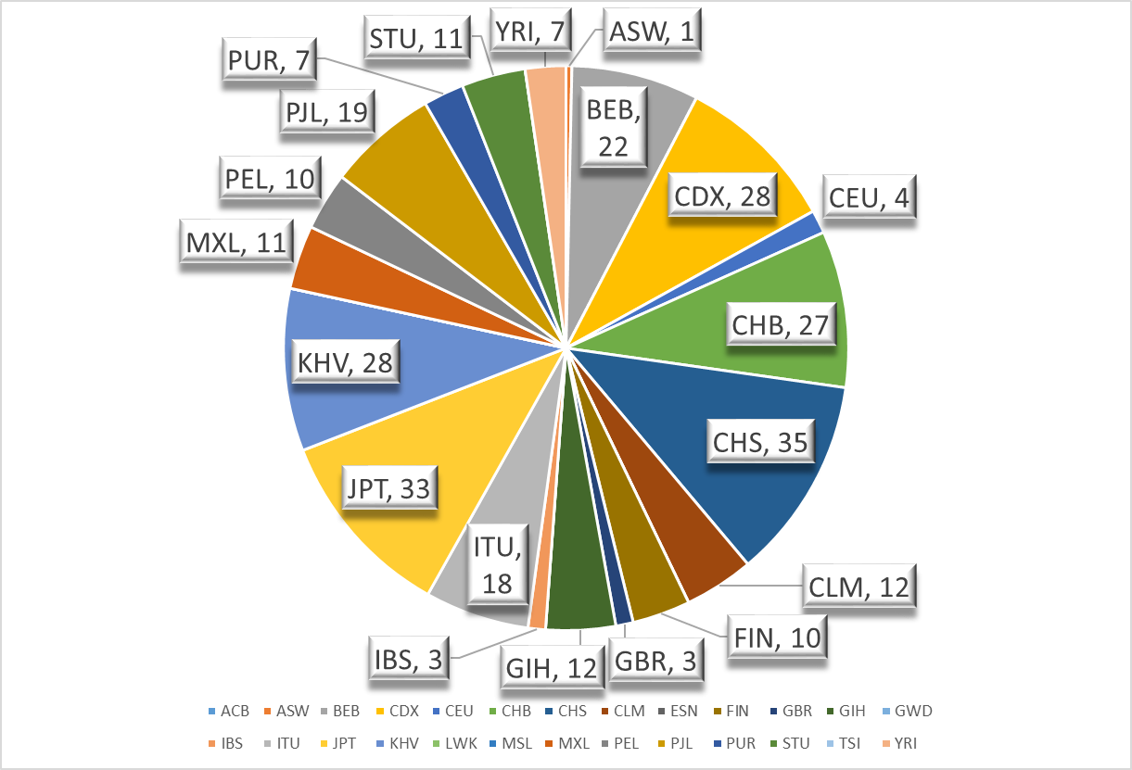

Conserved ACKR1 Gene Sequences of More Than 73,000 Nucleotides Among Individuals of the 1000 Genomes Project
Bo Lan^{1,2}, Kshitij Srivastava¹, Willy A. Flegel¹
¹Department of Transfusion Medicine, NIH Clinical Center, National Institutes of Health, Bethesda, MD
²Tufts University, Medford, MA
Goals
Methods
Results
Future Directions
Identify conserved haplotype sequences in and around the ACKR1 gene.
From conserved haplotype sequences, construct longest available haplotype for the ACKR1 gene and adjacent intergenic regions in 26 different populations of the 1000 Genomes Project (1000GP).
Find the population representation of each distinct haplotype in the 1000GP.
Download genotype data of ACKR1 between last variant of CADM3 and first variant of MPTX2 of 2,504 individuals in the 1000GP.
We analyzed more than 73 kb nucleotides of the ACKR1 gene and its intergenic regions between CADM3 and MPTX1 (Figure 2). We found 34 haplotypes spanning their full length from 73,355 nucleotides to 73,370 nucleotides, deviating from the reference sequence of 73,365 nucleotides only due to insertions
Find the nucleotide length of all haplotypes.
Identify frequently occurring, long-range conserved haplotypes for all 26 populations of the 1000GP.
Identify the clinical importance of long conserved haplotypes in the blood transfusion donor-recipient setting.
and deletions (Indels). Only 8 full length haplotypes were observed in more than one population (Figure 3). The most frequently observed haplotype (Figure 4) among all 846 distinct haplotypes occurred 301 times.
CADM3
NM_001127173.1
ACKR1
NM_002036.3
MPTX1
pseudogene
31,556nt
2,488nt
(NC_000001.10)
990nt
Background
Figure 2. The genomic locus analyzed spans 73,365 nucleotides. The start (green) and stop (red) codons of CADM3 and ACKR1 are labeled.
The 1000GP began in 2007 and created the largest catalogue of human genome data while finding genetic variants of at least 1% frequency in 26 different populations (Figure 1).
The final data set (phase 3) produced by the 1000GP contains computationally phased haplotypes for 2504 individuals.
Haplotypes can be identified in an unambiguous way if they are completely homozygous or have at most one heterozygous nucleotide in the analyzed nucleotide sequence.
Longer reference sequences have shown to considerably increase genetic imputation accuracy, especially for low‐frequency variants (less than 1% in population).
The human ACKR1 gene, comprising of two exons and a single intron, encodes a multi-pass trans-membrane glycoprotein expressing the Duffy blood group antigens.
ACKR1 is located on the long arm of chromosome 1 at 1q23.2 between CADM3 gene and MPTX1 pseudogene.
As a proof of principle, we have used ACKR1 data from the 1000GP to identify long unambiguous haplotypes that can be used as templates to design microarray technologies, impute genotypes and map next generation sequencing data, which will enhance the reliability in clinical diagnostics.
Clinical Applications
ACKR1
73,363 nucleotides
8
Abbreviation | Population Name
ACB | African-Caribbean
ASW | African-American SW
BEB | Bengali
CDX | Dai Chinese
CEU | Utah European
CHB | Han Chinese
CHS | Southern Han Chinese
CLM | Colombian
ESN | Esan
FIN | Finnish
GBR | British
GIH | Gujarati
GWD | Gambian Mandinka
IBS | Spanish
ITU | Indian
JPT | Japanese
KHV | Kinh Vietnamese
LWK | Luhya African
MSL | Mende African
MXL | Mexican-American
PEL | Peruvian
PJL | Punjabi
PUR | Puerto Rican
STU | Sri Lankan
TSI | Tuscan European
YRI | Yoruba African
Blood donor ACKR1 haplotypes can be matched with recipient haplotypes to determine most suitable donor.
Use of long-range conserved haplotypes in phasing of next generation sequencing data.
Remove individuals with more than one heterozygous SNP within 2,488 nucleotides of ACKR1 gene (NM_002036.3 + 480 nucleotides of intron 1).
ACKR1
2
73,363 nucleotides
ACKR1
73,361 nucleotides
5
ACKR1
73,360 nucleotides
4
Acknowledgments
1,337 individuals remained.
ACKR1
Obtain the 1,337 individuals’ 2,674 haplotypes and sort them based on their length.
73,360 nucleotides
2
Bo Lan would like to thank Dr. Willy Flegel and Dr. Kshitij Srivastava for their tremendous efforts in providing him with the experience of working in a transfusion medicine laboratory setting and in the incredible mentorship they have provided him throughout his project.
ACKR1
73,356 nucleotides
5
Move on either side of the ACKR1 gene and select haplotypes between 2 heterozygous SNPs to obtain unambiguous haplotypes.
ACKR1
2
Figure 1. Map of 1000 Genome Populations in 5 continents.
73,356 nucleotides
ACKR1
73,355 nucleotides
2
Find haplotypes that share sequences.
Figure 3. Full length haplotypes observed in more than one population with pie charts showing number of observations in each population and total observations. Population key provided.
References
Srivastava K, Wollenberg KR, Flegel WA. The phylogeny of 48 alleles,
experimentally verified at 21kb,
and its
application
to clinical
allele
detection.
J Transl
Med. 2019
Feb 11;
17(1):43
Auton, A. and Abecasis, G. R., et al. A global reference for human genetic variation. Nature 526, 68–74 (2015).
List number of times observed for each of the 2,674 haplotypes.
ACKR1 ((NM_002036.3 + 480 nucleotides of intron 1)
3,542 nucleotides
846 distinct haplotypes were observed.
Figure 4. The most frequently observed ACKR1 haplotype structure and population representation.
Find number of observations in each of the 26 populations for each of the 846 distinct haplotypes.
Conclusions
34 full length haplotypes of more than 73 kb nucleotide were found. Only 8 of these haplotypes were observed in more than one population and are of special interest as they may share long, conserved sequences that are universal in all populations.
The most frequently observed haplotype covers 3542 nucleotides, which may be a suitable haplotype for future reference purposes.
List out longest and most common haplotypes.

